Slide 1
Modul III RPL Berorientasi Obyek ELABORATION PHASE (Iterasi I)
Diterjemahkan dari
Sumber:
1. Whitten, et.al. Systems Analysis & Design Methods. 7th ed.
2. Rational Unified Process – Best Practices for Software Development Team
Jurusan Informatika
Universitas Sanata Dharma

Slide 2
Kompetensi
Memahami makna elaboration phase
Mampu mendefinisikan pemodelan obyek.
Mengetahui bagaimana membangun pemodelan obyek.
Mendefinisikan UML dan berbagai macam tipe diagram yang digunakan.
Mampu memperbaiki model use case model dari fase analisis kebutuhan menjadi model use case analisis.
Mampu mendefinisikan obyek bisnis
Mampu membangun activity diagram.
Mampu membangun diagram kelas analisis (analysis class diagram).
Notes:
No additional notes.

Slide 3
Makna Elaboration Phase
Silakan baca suplemen artikel ”Rational Unified Process – Best Practices for Software Development Team”
Fokus aktivitas utama pada elaboration phase adalah analisis dan disain (lihat grafik model iteratif RUP).
Elaboration phase akan dilakukan dalam beberapa iterasi.
Pada elaboration phase iterasi I, produk utama yang akan dihasilkan adalah model obyek yang berupa:
Model fungsi sistem (perbaikan use case dan skenario sistem)
Diagram aktivitas untuk skenario normal
Model kelas analisis
Notes:
Teaching Notes
This slide shows the how this chapter's content fits with the building blocks framework used throughout the textbook. Since the object-oriented approach attempts to unify DATA, PROCESSES, and COMMUNICATION, the emphasis of this chapter is upon all three. It also reflects the fact that OO analysis is done during the Requirements Analysis and Logical Design phases and that it involves not only systems analysts…but owners and users.

Slide 4
Pemodelan Obyek (Object Modeling)
Object-oriented analysis (OOA) – adalah sebuah pendekatan yang digunakan untuk :
Menggunakan obyek yang sudah ada untuk digunakan kembali (reuse) atau diadaptasi untuk penggunaan baru
Mendefinisikan obyek baru atau obyek yang dimodifikasi dan digabungkan dengan obyek yang sudah ada untuk membangun suatu aplikasi bisnis.
Object modeling (Pemodelan Obyek) – Teknik untuk mengidentifikasi obyek yang ada dalam sistem dan relasi diantara obyek-obyek tersebut.
Notes:
Teaching Notes
The object modeling technique prescribes the use of methodologies and diagramming notations that are completely different from the ones used for data modeling and process modeling.
In the late 1980s and early 1990s many different object-oriented methods were being used throughout the industry. The most notable of these were Grady Booch’s Booch Method, James Rumbaugh’s Object Modeling Technique (OMT), and Ivar Jacobson’s Object-Oriented Software Engineering (OOSE).

Slide 5
Pengantar UML
Unified Modeling Language (UML) – aturan-aturan pemodelan yang digunakan untuk mendeskripsikan sistem perangkat lunak dalam bentuk kumpulan obyek.
UML bukan sebuah metode untuk mengembangkan sistem, akan tetapi notasi-notasi yang digunakan secara umum sebagai standar untuk pemodelan obyek.
Notes:
Teaching Notes
In 1994 Grady Booch and James Rumbaugh joined forces to merge their respective object-oriented development methods with the goal of creating a single, standard process for developing object-oriented systems.
Ivar Jacobson joined them in 1995 and the three altered their focus to create a standard object modeling language instead of a standard object-oriented approach or method.
Referencing their own work as well as countless others in the OO industry, the Unified Modeling Language (UML) version 1.0 was released in 1997. UML version 2.0 is expected to be released in late 2000.
At the time of this writing, Booch, Rumbaugh, and Jacobson have developed and marketed an object modeling methodology called the Unified Method or Objectory.

Slide 6
Obyek dan Atribut
Obyek – sesuatu yang dapat dilihat, disentuh atau dirasakan dan digunakan pengguna serta akan disimpan data dan perilakunya. Obyek dapat berupa:
Orang, tempat, benda atau kejadian
Pegawai, pelanggan, guru, dosen, mahasiswa, murid.
Gudang, kantor, bangunan, ruangan.
Kendaraan, produk, komputer, video.
Atribut – data yang menyatakan sifat dari obyek
Notes:
Teaching Notes
There are several concepts that object-oriented analysis is based on. Some of these concepts require a totally new way of thinking about systems and the development process. These concepts have presented a formidable challenge to veteran developers who must relearn how they have traditionally viewed systems.
Object-oriented approaches to systems development are concerned with identifying attributes that are of interest regarding an object. It is important to note that with advances in technology, attributes have evolved to include more than simple data characteristics. Today, objects may include newer attribute types, such as a bitmap or a picture sound, or even video.
Have students provide examples of objects and their attributes that exist in the classroom. For instance, pen is an object; color of ink is an attribute.

Slide 7
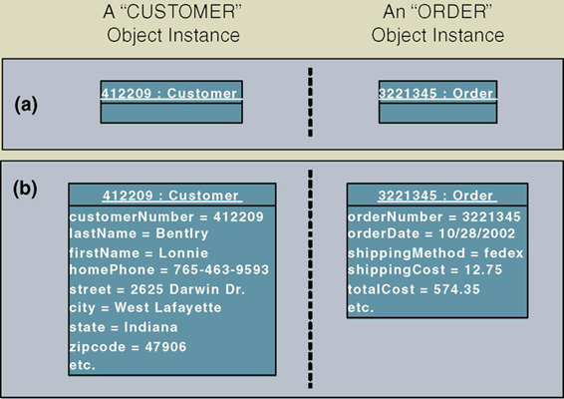
Contoh Kejadian (Object Instances)
Object instance – orang, tempat, benda atau kejadian khusus beserta nilai untuk setiap atribut dari obyek.
Contoh:
Notes:
Teaching Notes
This figure depicts the symbol for representing an object instance using the UML modeling notation. An object is represented using a rectangle. The name of the object instance and its classification are underlined and appear at the top of the symbol. The attribute values for the object instance are optionally recorded within the symbol and are separated from the object name with a line.
The name of an object instance is the value of the attribute that uniquely identifies it. The attribute customer number, whose value is 412209, uniquely identifies that instance of customer. Thus, 412209 is the name of the object instance and customer is its classification.

Slide 8
Perilaku & Enkapsulasi
Perilaku (behavior) – hal-hal yang dapat dikerjakan obyek dan merupakan fungsi yang dikenakan pada data (atribut) dari obyek tersebut.
dalam paradigma OO, perilaku obyek disebut metode, operasi, atau layanan (method, operation, or service).
Enkapsulasi (Encapsulation) – pembungkusan beberapa item ke dalam satu unit.
Notes:
Teaching Notes
In encapsulation, both attributes and behavior of the object are packaged together. The only way to access an object's attributes is through that object’s behaviors. No other object may perform that object’s behavior.
Have students identify the behaviors of a door, window, or VCR.

Slide 9
Kelas Obyek
Kelas Obyek (Object classes) – himpunan obyek yang memiliki atribut dan perilaku yang sama. Kadang hanya disebut dengan kelas
Notes:
Conversion Notes
This is a new slide in the seventh edition

Slide 10
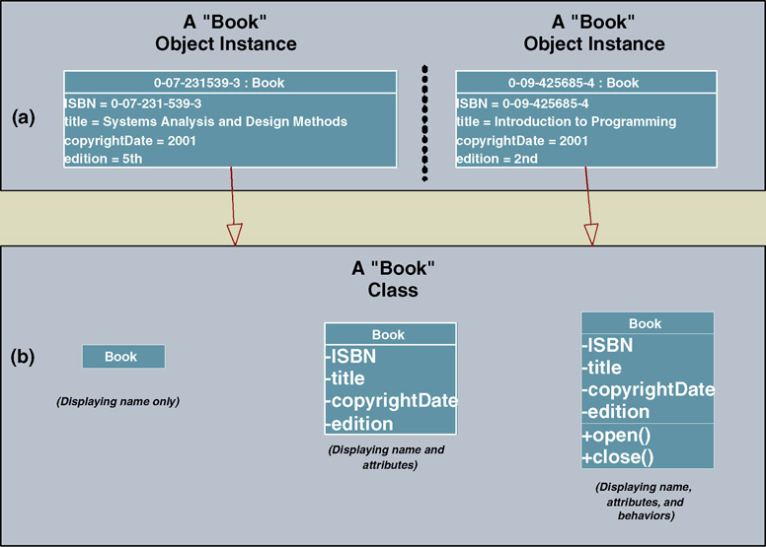
Merepresentasikan kelas dalam UML
Notes:
Teaching Notes
In UML an object class is represented using a rectangle symbol.
The object rectangle is divided into three portions.
The top portion contains the name of the class.
The middle portion contains the names of the attributes.
The lower portion contains the behaviors (or methods).
To simplify the appearance of a diagram, or to specify more details about a class, class symbols can be drawn without methods or attributes, or the attribute portion can be expanded to include data types, lengths, etc. The appearance depends on what the author of the diagram is intending to communicate.

Slide 11
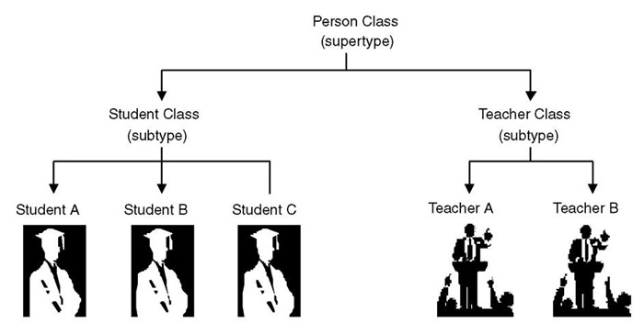
Pewarisan
Pewarisan (Inheritance) – konsep yang menyatakan bahwa metode dan/ atau atribut dalam kelas dapat diturunkan atau digunakan kembali oleh kelas lain.
Notes:
Teaching Notes
Inheritance is a critical concept of OO. In fact for a programming language or DBMS to be considered OO, it must support inheritance. In inheritance, the child class inherits the attributes and methods from its parent class(s).

Slide 12
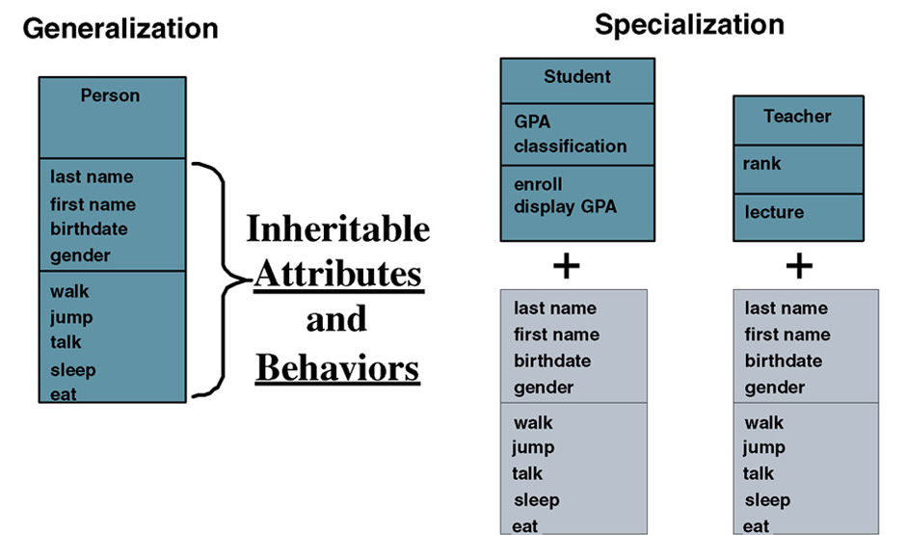
Pewarisan (cont’d)
Notes:
Teaching Notes
The terms Generalization and Specialization will be defined on the next slide.
Walk the students through this diagram.
The Person object has an attribute last name. Therefore the Student and Teacher objects that are based on Person also have an attribute last name as well as their own attributes (GPA or rank).
The Person object has a method walk. Therefore Student and Teach also have a method walk as well as their own methods (enroll or lecture).

Slide 13
Generalisasi/Spesialisasi, Supertype, dan Subtype
Generalisasi/spesialisasi – atribut dan perilaku yang sama untuk beberapa kelas dikelompokkan ke dalam kelas tersendiri yang disebut supertype.
Supertype – entitas yang berisi atribut dan perilaku yang sama untuk satu atau lebih subtipe kelas. Juga disebut abstract atau parent class.
Subtype – kelas yang mewarisi (inherit) atribut dan perilaku dari kelas supertype serta mungkin juga berisi atribut dan perilaku lain yang khusus. Juga disebut kelas anak (child). Jika berada pada tingkat yang paling rendah dalam hirarki pewarisan, akan disebut kelas konkret (concrete).
Notes:
Teaching Notes
The previous slide illustrates these terms.
The class supertype will have one or more one-to-one relationships to object class subtypes. These relationships are sometimes called “IS A” relationships (or “WAS A” or “COULD BE A”) because each instance of the supertype “is also an” instance of one or more subtypes.

Slide 14
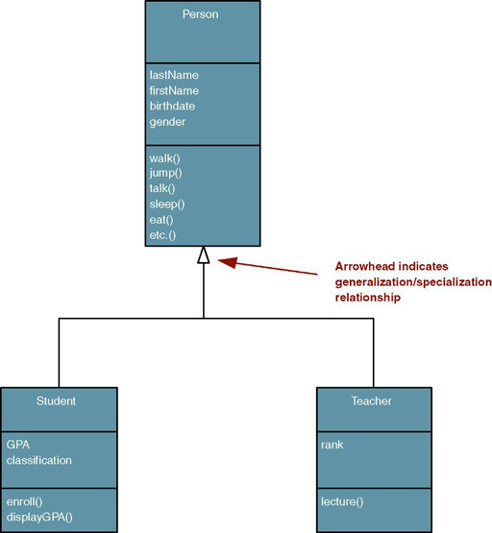
Representasi UML untuk Generalisasi/Spesialisasi
Notes:
Teaching Notes
Have students identify what attributes and methods are inherited by the STUDENT and TEACHER classes.

Slide 15
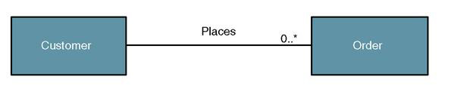
Relasi Obyek / Kelas
Relasi Obyek/ Kelas – asosiasi bisnis yang ada diantara satu atau lebih obyek dan kelas
Notes:
Teaching Notes
Objects and classes do not exist in isolation. The things they represent interact with and impact one another to support the business mission.
An object/class relationship is graphically illustrated in UML as a connecting line between two classes. This relationship is commonly referred to as an association. The line is labeled with a verb phrase that describes the association. All associations are implicitly bidirectional, meaning that they can interpreted in both directions.
The figure above shows the complexity or degree of each association. For example, in the above business assertions, we must also answer the following questions:
Must there exist an instance of CUSTOMER for each instance of ORDER? Yes!
Must there exist an instance of ORDER for each instance of CUSTOMER? No!
How many instances of ORDER can exist for each instance of CUSTOMER? Many!
How many instances of CUSTOMER can exist for each instance of ORDER? One!

Slide 16
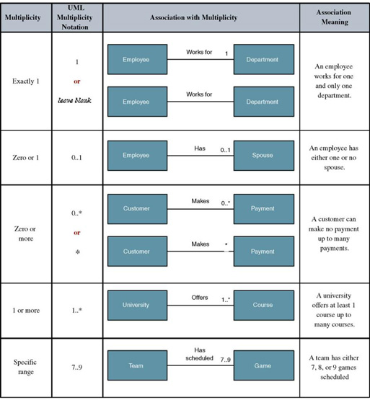
Notasi UML untuk Multiplicity
Multiplicity – jumlah kejadian minimum dan maksimum dari sebuah obyek / kelas untuk satu kejadian dari obyek / kelas yang terkait (berelasi).
Notes:
Teaching Notes
Because all associations are implicitly bidirectional, multiplicity must be defined in both directions for every association.

Slide 17
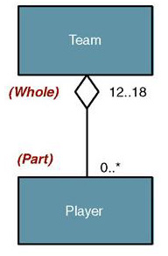
Agregasi
Agregasi – sebuah relasi yang menyatakan bahwa satu kelas “utuh (whole)” yang lebih besar memuat satu atau lebih kelas “bagian (part)” yang lebih kecil. Sebaliknya, kelas “bagian” adalah bagian dari kelas “utuh”
Dalam UML 2.0 notasi agregasi sudah tidak dipakai lagi
Notes:
Teaching Notes
Aggregation relationships do not support inheritance. Their benefit lies in the ability to send a message to the parent class and that message is automatically applied to all the child classes.
Have students provide other examples of objects where aggregation relationships are appropriate (car – or any bill of material, order-line item, etc.).

Slide 18
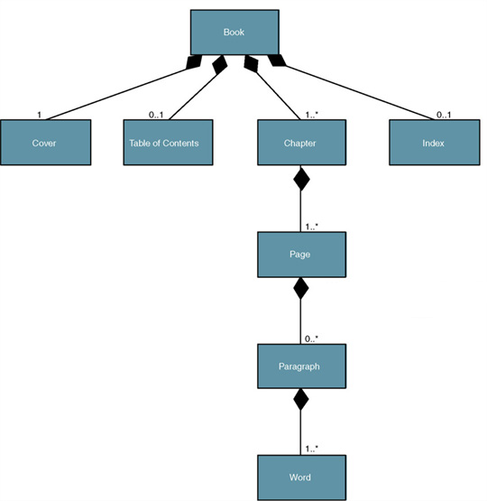
Komposisi
Komposisi – relasi agregasi yang menyatakan bahwa yang “utuh (whole)” bertanggung jawab untuk membuat dan menghapus “bagian (part)”. Jika “whole” dihapus, maka “part” juga pasti terhapus.
Notes:
Teaching Notes
All composition relationships are aggregation relationships. But not all aggregation relationships are composition relationships.
Ask students why composition is appropriate for the Book and Chapter classes but not for the Team class.

Slide 19
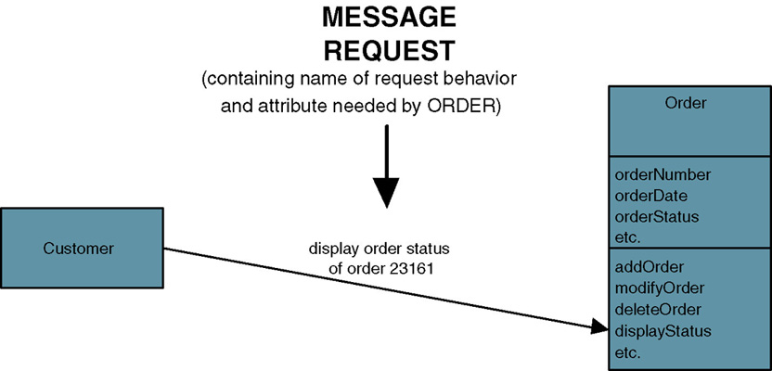
Pesan / Message
Message – komunikasi yang terjadi jika suatu obyek menggunakan metode obyek lain untuk meminta informasi atau hal-hal lain.
Notes:
Teaching Notes
The object sending a message does not need to know how the receiving object is organized internally or how the behavior is to be accomplished, only that it responds to the request in a well-defined way.
A message can be sent only between two objects that have an association between them.

Slide 20
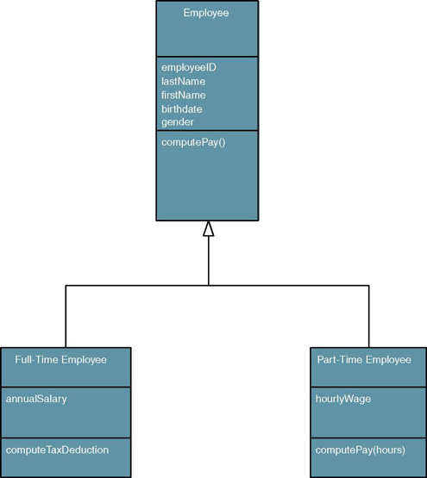
Polimorfisme
Polimorfisme – obyek yang berbeda dapat merespon pesan yang sama dengan cara yang berbeda.
Override – suatu teknik di mana suatu sub-kelas (subtype) menggunakan atribut atau perilaku milik dirinya sendiri, bukan atribut atau perilaku yang diturunkan dari supertype.
Notes:
Teaching Notes
Polymorphism supports reusability in that the same message can be sent to different objects and be interpreted different ways. For example, let’s say we have a method called “Compute Pay” and two objects named FULL-TIME EMPLOYEE and PART-TIME EMPLOYEE. The same “compute pay” message can be sent to both objects but how each object reacts/responds to the message is different. A full-time employee’s pay may be composed of a weekly salary (minus deductions) whereas a part-time employee only gets paid for the hours worked (minus deductions).
When the PART-TIME EMPLOYEE object receives a message to “compute pay,” it will override the behavior of the EMPLOYEE supertype and use its own behavior. But because of polymorphism, the object sending the message never knows the difference.

Slide 21
Diagram –Diagram dalam UML 2.0
Diagram | Description
Use Case | Menggambarkan interaksi antara sistem dan pengguna/sistem eksternal. Secara grafis, menggambarkan siapa yang akan menggunakan sistem dan dengan cara bagaimana pengguna berinteraksi dengan sistem, Narasi use case digunakan untuk menggambarkan secara tekstual langkah-langkah dalam interaksi sistem dengan penggunanya.
Activity (Aktivitas) | Menggambarkan alur aktivitas sekuensial dari tiap use case/ proses bisnis/logika sistem.
Class (Kelas) | Menggambarkan struktur obyek dari sistem, yang memuat obyek-obyek yang terdapat dalam sistem beserta hubungan/relasi antar obyek.
Object (Obyek) | Serupa dengan class diagram, namun digunakan untuk memodelkan kejadian (instance) obyek dengan nilai-nilainya. Dipakai oleh pengembang sistem untuk memotret keadaan obyek sistem pada suatu saat tertentu.
State Machine | Memodelkan bagaimana kejadian dapat mengubah keadaan (state) dari suatu obyek sepanjang “hidupnya” obyek tersebut. Menggambarkan berbagai macam keadan yang dapat dialami suatu obyek beserta transisi antar keadaan tsb.
Composite Structure | Mendekomposisi struktur internal kelas, komponen, atau use case.
Notes:
Conversion Notes
With the seventh edition we have switched to UML 2.0.
Teaching Notes
As we study an overview of the systems analysis life cycle, three chapters will delve into the core UML diagrams:
Chapter 7 – FAST Requirements Analysis Phase
Use Case Diagrams
Chapter 10 – FAST Logical Design Phase
Activity Diagrams
System Sequence Diagrams (a high-level kind of Sequence Diagram)
Class Diagrams
Chapter 18 – FAST Physical Design Phase
Sequence Diagrams
Class Diagrams (with more detail)
State Machine Diagrams
Communication Diagrams
Component Diagrams
Deployment Diagrams

Slide 22
UML 2.0 Diagrams (cont.)
Diagram | Deskripsi
Sequence (Sekuen) | Menggambarkan secara grafis bgmn obyek-obyek berinteraksi satu sama lain melalui pesan selama eksekusi suatu use case/operasi. Mengilustrasikan bagaimana pesan dikirim dan diterima oleh obyek dan bgmn urutannya.
Communication (Komunikasi) | (Dalam UML 1.X disebut Collaboration diagram) . Menggambarkan interaksi obyek-obyek melalui pesan. Lebih berfokus pada struktur internal obyek dalam format jaringan, daripada urutannya seperti pada diagram sekuen.
Interaction Overview (Overview Interaksi) | Mengkombinasikan fitur-fitur dari diagram sekuen dan diagram aktivitas untuk menunjukkan bgmn obyek-obyek berinteraksi dalam tiap aktivitas dalam suatu use case.
Timing | Bentu diagram interaksi yang lain yang berfokus pada kendala waktu dalam perubahan keadaan dari suatu obyek tunggal atau kelompok. Bermanfaat untuk merancang embedded software bagi suatu piranti.
Component | Menggambarkan organisasi kode program yang dibagi dalam beberapa komponen dan bagaimana komponen-komponen tsb berinteraksi.
Deployment | Menggambarkan konfigurasi komponen software dalam arsitektur fisik dari “node-node” sistem hardware.
Package | Menggambarkan bagaiman kelas-kelas atau unit-unit dalam UML yang lain diorganisasi ke dalam paket (berhubungan dengan package dalam Java, C++ atau .NET ) serta ketergantungan antar paket
Notes:
Conversion Notes
With the seventh edition we have switched to UML 2.0.
Teaching Notes
As we study an overview of the systems analysis life cycle, three chapters will delve into the core UML diagrams:
Chapter 7 – FAST Requirements Analysis Phase
Use Case Diagrams
Chapter 10 – FAST Logical Design Phase
Activity Diagrams
System Sequence Diagrams (a high-level kind of Sequence Diagram)
Class Diagrams
Chapter 18 – FAST Physical Design Phase
Sequence Diagrams
Class Diagrams (with more detail)
State Machine Diagrams
Communication Diagrams
Component Diagrams
Deployment Diagrams

Slide 23
Proses Pemodelan Obyek
Memodelkan fungsi sistem.
Memperbaiki model use case (jika perlu)
Membuat diagram aktivitas untuk setiap use case
Memodelkan kelas analisis:
Mengidentifikasi obyek dan relasinya
Membuat diagram kelas
Notes:
Teaching Notes
These are object-oriented analysis general activities

Slide 24
Pemodelan fungsi sistem
Langkah 1
Memperbaiki model use case

Slide 25
Memperbaiki Model Use-Case Sistem
System analysis use case – use case yang mendokumentasikan hubungan diantara sistem dan pengguna sistem. Tentukan apa yang dibutuhkan tanpa memperhatikan detail dan kendala implementasi.
Mengidentifikasi, mendefinisikan aktor baru
Mengidentifikasi, mendefinisikan use case baru
Mengidentifikasi kemungkinan penggunaan kembali.
Memperhalus/ memperbaiki diagram use case jika diperlukan.
Mendokumentasikan narasi use case
Notes:
Teaching Notes
As the analyst continues to learn more about the system and its requirements, the analyst may discover new actors who interact with the system and new use cases.
When two use cases have the same business goal but different users or interface technology, both use cases may share common steps. We can extract these common steps into a separate use case called an abstract use case. Or we can extract complex steps of a single use case into an extension use case.

Slide 26
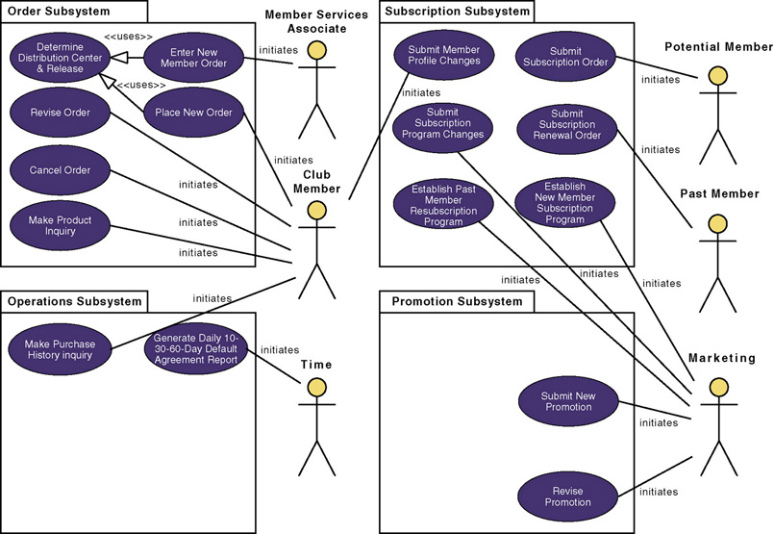
Revisi System Diagram Model Use-Case
Notes:
Teaching Notes
A use case model diagram can be used to graphically depict the system scope and boundaries in terms of use cases and actors.
The use case model diagram for the Member Services System is shown in the above figure. It was created using Popkin Software’s System Architect and represents the relationships between the actors and use cases defined for each business subsystem.
The subsystems (UML package symbol) represent logical functional areas of business processes.
The partitioning of system behavior into subsystems is very important in understanding the system architecture and is very key to defining your development strategy — which use cases will be developed first and by whom.

Slide 27
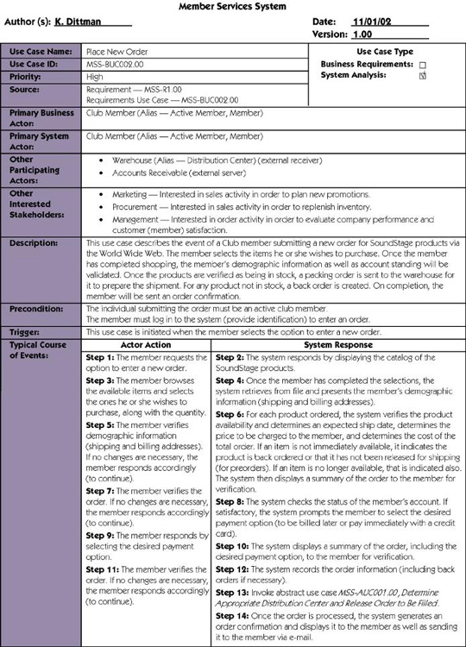
Narasi Use-Case
Notes:
Teaching Notes
If Chapter 7 was covered, this will be review

Slide 28
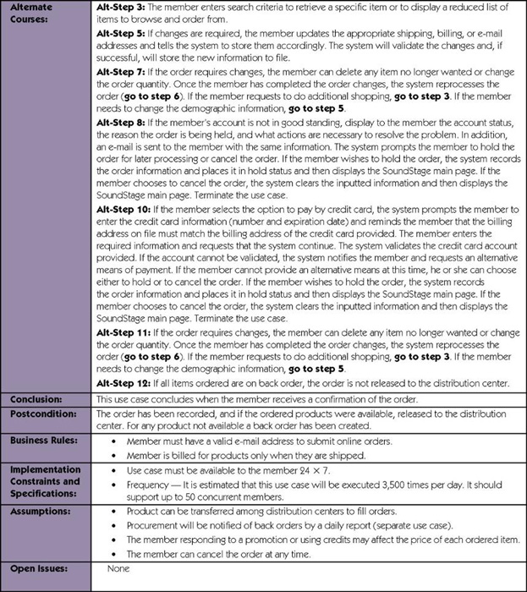
Narasi Use-Case (cont’d)
Notes:
Teaching Notes
If Chapter 7 was covered, this will be review

Slide 29
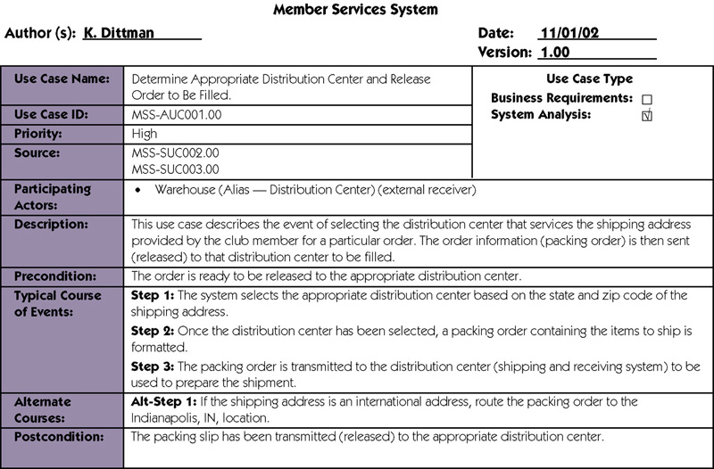
Narasi Use-Case Abstrak
Notes:
No additional notes.

Slide 30
Pemodelan Fungsi Sistem
Langkah 2
Membuat diagram aktivitas

Slide 31
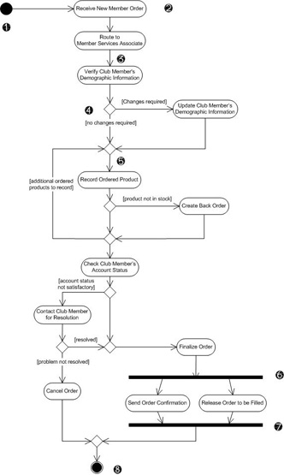
Pemodelan aktivitas Use-Case
Activity diagram – diagram yang digunakan untuk menggambarkan
Proses bisnis,
Langkah-langkah use case
Logika perilaku obyek/ metode
Notes:
Conversion Notes
In UML 2.0 the activity diagram renames some symbols and uses them more formally.

Slide 32
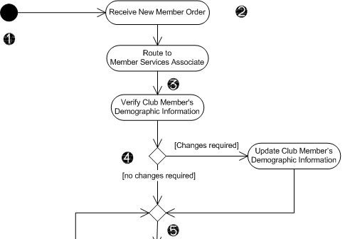
Notasi Diagram Aktivitas
Node awal / Initial node :
lingkaran penuh yang menyatakan awal proses.
Aksi / Actions – kotak berujung bulat yang menyatakan langkah tunggal. Sederetan aksi akan membentuk aktivitas total yang
diperlihatkan dengan diagram.
Alur / Flow - panah pada diagram menunjukkan alur aksi. Tidak perlu kete-
rangan kecuali jika alur tsb keluar dari notasi keputusan.
4. Keputusan / Decision – bentuk belah ketupat dengan satu alur masuk dan dua atau lebih alur keluar. Alur keluar diberi keterangan untuk mengindikasikan kondisi.
5. Pengabungan / Merge – bentuk belah ketupat dengan banyak alur masuk dan satu alur keluar. Notasi ini menggabungkan alur yang sebelumnya dipisah dengan keputusan. Proses berlanjut dengan banyak alur masuk ke penggabungan.
Notes:
Conversion Notes
This slide has been extensively revised for the seventh edition to correspond with UML 2.0 notation.

Slide 33
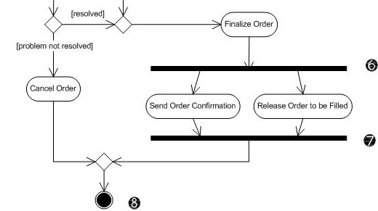
Notasi Diagram Aktivitas (cont.’d
Pemisah/ Fork – garis hitam dengan satu alur masuk dan dua atau lebih alur keluar. Aksi pada alur paralel dibawah pemisah dapat terjadi dalam beberapa urutan atau secara bersamaan
Penghubung / Join – garis garis hitam dengan dua atau lebih alur masuk dan satu alur keluar. Menandai akhir dari proses bersamaan. Semua aksi yang masuk ke join harus diselesaikan sebelum proses berlanjut.
Aktivitas akhir / Activity final – lingkaran padat didalam lingkaran berlubang menyatakan akhir proses.
Notes:
Conversion Notes
This slide has been extensively revised for the seventh edition to correspond with UML 2.0 notation.

Slide 34
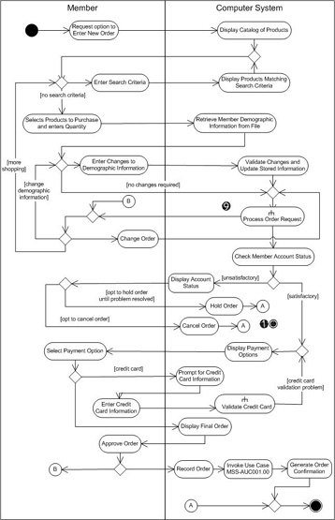
Diagram Aktivitas dengan Partisi
Indikator subaktivitas / Subactivity indicator – simbol dalam aksi ini menandakan bahwa aksi dipecah menjadi diagram aktivitas yang terpisah. Hal ini untuk membantu diagram aktivitas agar tidak menjadi kompleks.
Penghubung / Connector – Huruf didalam lingkaran membantu untuk mengatur kompleksitas. Alur masuk ke dalam konektor akan melompat ke alur keluar dengan huruf yang sesuai.
Diagram aktivitas dibagi menjadi beberapa bagian untuk menunjukkan aksi yang dibentuk oleh aktor atau kelas tertentu. Pembagi yang digunakan sering disebut swimlane
Notes:
Conversion Notes
This slide has been extensively revised for the seventh edition to correspond with UML 2.0 notation.
Teaching Notes
In addition to the subactivity indicator and the connector, this activity diagram shows partitions (formerly swmlanes). Partitions are especially useful when including receiver actors.

Slide 36
Petunjuk Membuat Diagram Aktivitas
Mulailah dengan node awal untuk titik awal.
Tambahkan partisi jika relevan untuk analisis yang dibuat.
Tambahkan aksi untuk setiap langkah utama dari use case.
Tambahkan alur dari setiap aksi ke aksi lain, keputusan atau node akhir. Setiap aksi hanya mendapat satu alur masuk dan satu alur keluar menuju ke forks, joins, decisions, dan merges.
Tambahkan decisions jika alur dipecah menjadi beberapa pilihan. Jangan lupa untuk menggabungkan kembali dengan merge.
Tambahkan forks dan joins jika aktivitas akan dilakukan secara paralel.
Akhiri proses dengan notasi untuk akhir aktivitas.
Notes:
Conversion Notes
This is a new slide for the seventh edition.

Slide 37
CASE Tools
Argo UML (http://argouml.tigris.org/)
Catalyze
Rational Rose
Eiffel 3
Paradigm Plus
Proxy Designer

Slide 38
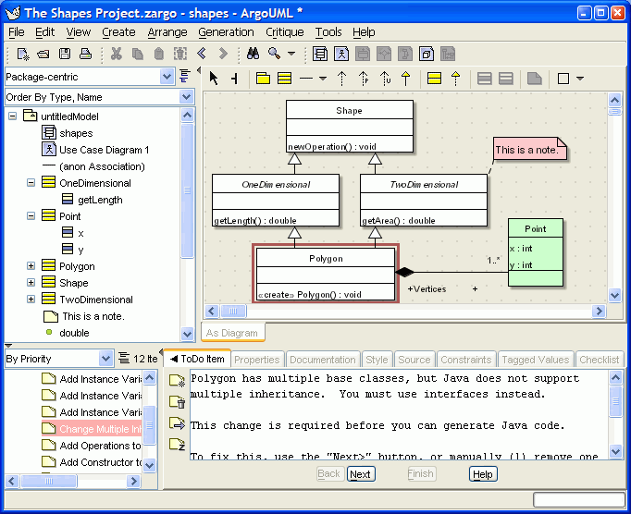

Slide 39
Contoh Diagram Aktivitas

Slide 40
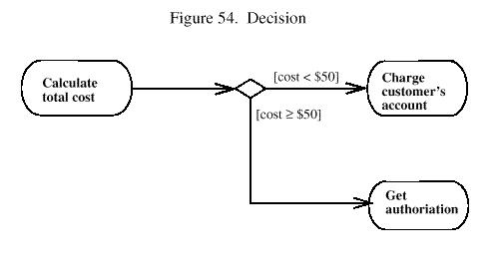
Contoh Diagram Aktivitas

Slide 41
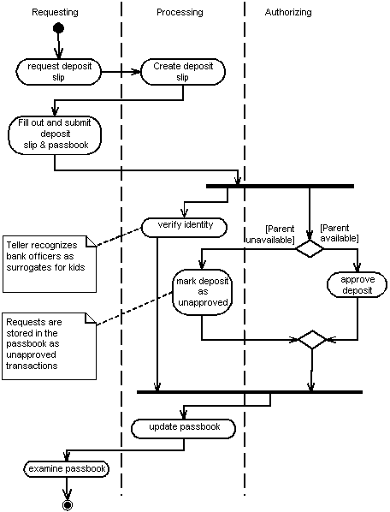

Slide 42
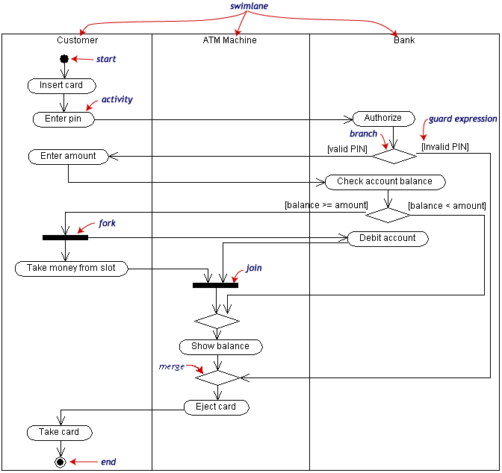

Slide 43
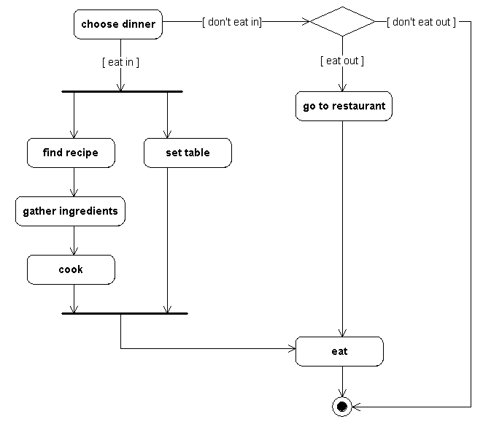

Slide 44
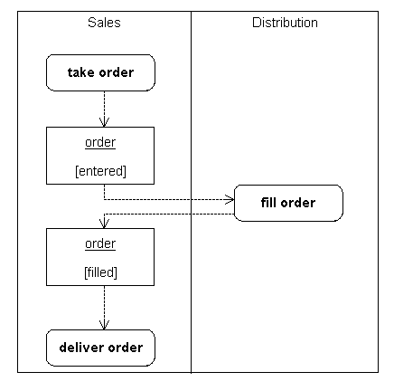

Slide 45
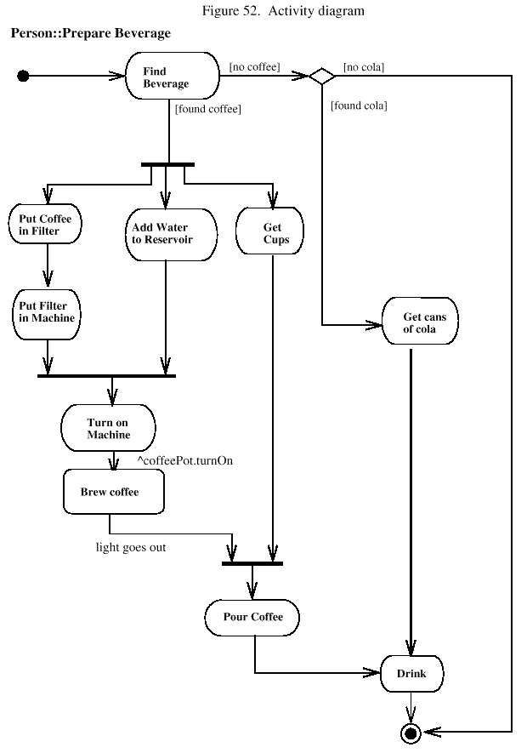

Slide 46
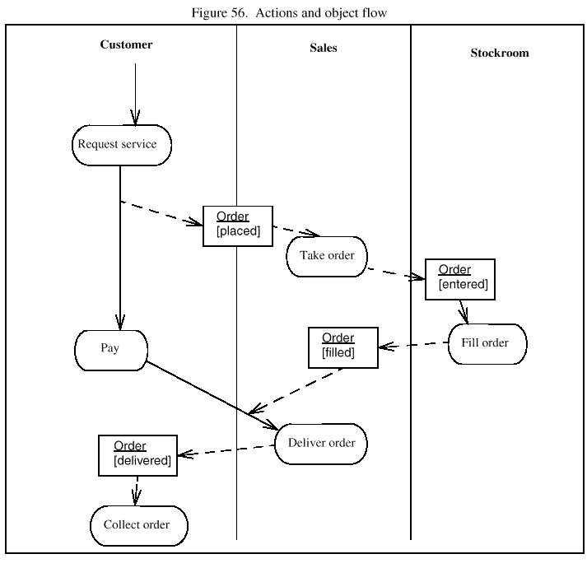

Slide 47
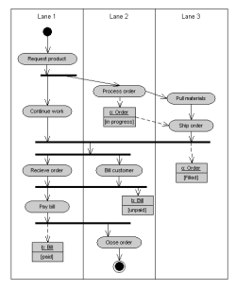

Slide 48
TUGAS KELOMPOK RPL TAHAP II ELABORATION PHASE ITERASI I
Untuk tiap kelompok :
Tinjaulah kembali laporan proyek tahap I RPL (Project Charter & SRS), dan pertajam bagian-bagian yang perlu .
Buat revisi diagram use case dari proyek Anda.
Buat diagram aktivitas untuk setiap use case.

